Slide 1

Mexico’s Passport Renewal Bot
Research & Design Recommendations for Mexico’s Ministry of Foreign Affairs
Notes:
Stephanie

Slide 2
The Team
Antonio Aranda-Eggermont
Stephanie Blucker
Anqi Cao
Patriya Wiesmann
Mojin Yu
Advisor: Dr. Saiph Savage
Developer: Saul
Notes:
Stephanie

Slide 3
What We’ll Cover Today
01
02
03
The Problem & Planning
Research & Findings
Design Recommendations
What we sought to address and how.
What we discovered through our research.
The solution we proposed.
Notes:
Stephanie

Slide 4
Problem & Planning
Notes:
Stephanie

Slide 5

The Problem
Mexico’s passport renewal process can be confusing. The government wanted to design a bot to streamline the process, but they needed to know more about users’ current experiences, as well as what they wanted from the bot.
Notes:
Stephanie

Slide 6
Project Planning
Literature Review
Data Analysis
Testing & Iteration
Cross-functional Discussion
User Interviews
Prototyping
Localization & Implementation
Future Efforts
Notes:
Patriya
Hi everyone, so here’s depiction of our research and design journey the past two week. This included cross-functional discussions, literature review, user interviews, analysis through affinity diagramming, and prototyping. The last two, testing and implementation are efforts we hope to accomplish moving forward.

Slide 7
Research & Findings
Notes:
Patriya
Alright, now we’re going to dive deeper into our research and findings.

Slide 8
Cultural Theory - Mexico
Power Distance
Individualism
Uncertainty Avoidance
Masculinity
Long-Term Orientation
High Context/Polychronic
High - established hierarchy and system of rules that are not often questioned
Low - values group membership, particularly family
High - preference for certainty and clarity, desire for a sure outcome
High - work-driven society that values decisiveness and assertiveness
Low - respect for tradition and desire for quick results
High - Values nuanced communication and multitasking
Notes:
Patriya
During initial research, we explored cultural theory. Having Antonio on our team allowed us to have a cultural ambassador to discuss these initial insights and helped spur discussions in the design process especially when combining dimensions. Using the Hofstede Model for Mexico we pulled these considerations into our designs that will be discussed later in our presentation.
From high PD, we learned there was an established hierarchy and system of rules
Low individualism meant that group membership was valued, particularly family
With High uncertainty avoidance, there was a preference for certainty and clarity
Having High masculinity meant a value of decisiveness and assertiveness.
With Long term orientation there would be respect for tradition and desire for quick results
Being High context/polychronic meant nuanced communication was valued including ease with multi-tasking
We also were able to pull this into our interview process.

Slide 9
User Interview Design
5
3
1 hour
Semi-structured interviews
Conducted in Spanish
One interviewer, multiple observers
Culture Theory: High Context & Uncertainty Avoidance
Open-ended questions to probe into passport experience.
Participants separated based on English skill level.
Including at least one notetaker.
Notes:
Patriya
We conducted 5 semi-structured interviews with 3 in Spanish.
For high context, since we could not conduct the interviews in person, we made sure to have our cameras on for gestures and facial expressions. For Uncertainty Avoidance, we made sure to be clear with questions and conduct the interviews in the participant’s preferred language, which you can see by the 3 spanish interviews.
Anqi will now discuss more about the participant profiles.

Slide 10

Participant Profile
GENDER
AGE
RESIDENCY
20-39
3/5
Mexico City
40-60
2/5
Mexico City & Spain
Mexico City & Oaxaca
LANGUAGES
Mexico City & Berlin
3/5
Male
2/5
Female
Spanish
3/5
English & Spanish
2/5
Notes:
Anqi

Slide 11
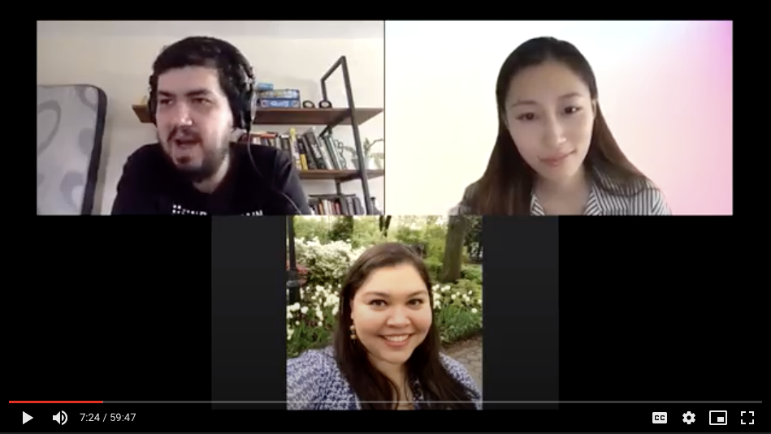
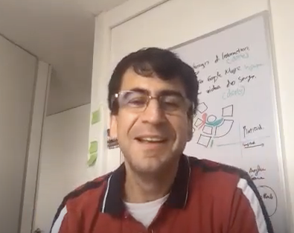
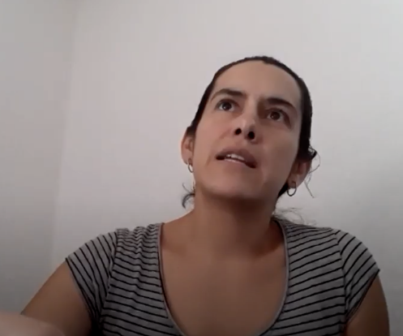
Interview Quotes
— P1
— P3
— P5
— P2
— P4
— P3
“The current process lacks personalization regarding how your individual situation fits in those requirements.”
“I don’t fear getting my personal data stolen. I feel no concern to provide identity info to the virtual assistant.”
“It’s not acceptable to get an approved appointment when required docs are missing or have errors.”
“The bot should be friendly and kind. It should speak to me in a formal manner with courtesy.”
“I prefer the option of a phone call where I can ask a human questions, which I’m more comfortable with.”
“I don’t want to feel that I have to adapt to the machine. I want the machine to adapt to me in a courteous manner.”
Notes:
Anqi

Slide 12
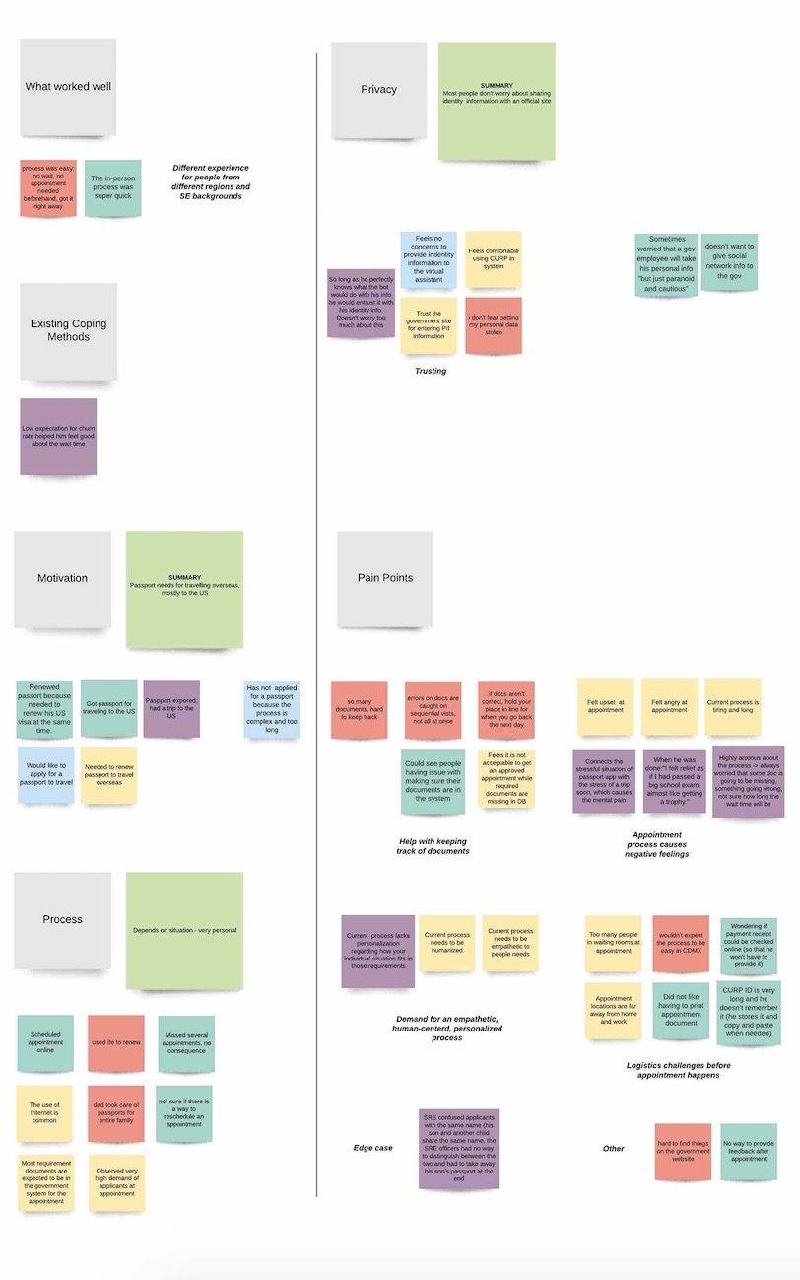
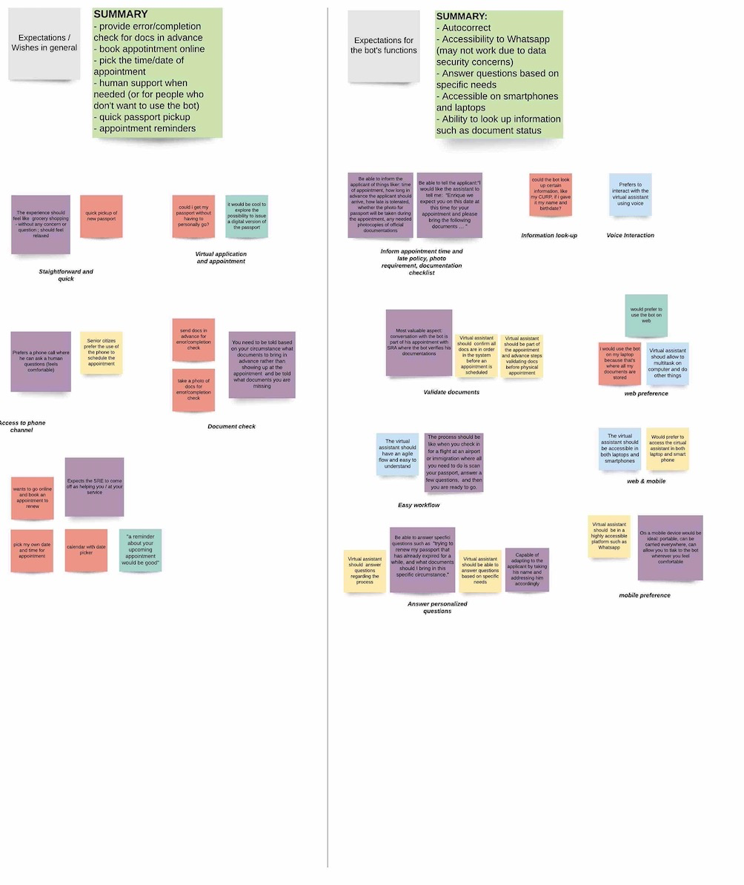
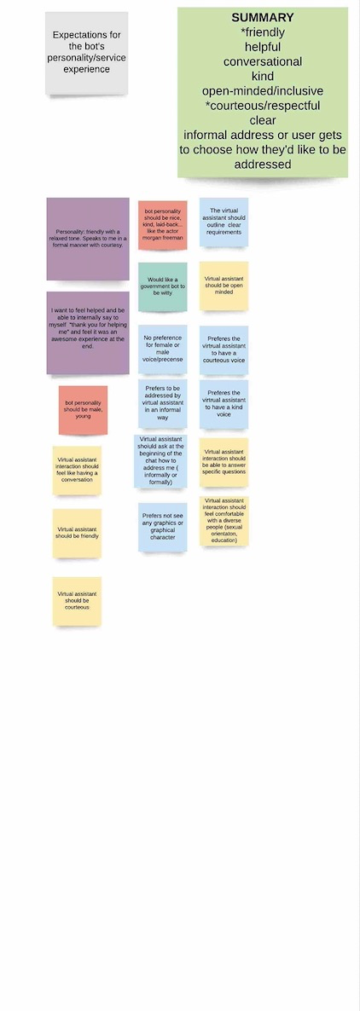
Affinity Diagram
Notes:
Anqi

Slide 13
Code Table
Data Privacy
Pain Points
Experience Expectations
Bot Expectations
Bot Personality
⅘ of the users felt no concern about providing personal info
1 user feared that a government employee would steal their info but thought they were being “paranoid and cautious”
1 user wouldn’t share social media info
Hard to keep track of documents
Appointment process causes negative feelings
Demand for an empathetic, human-centered, personalized process
Pre-appointment logistics challenges
Edge case
Straightforward, quick and relaxing
Virtual application and appointment
Access to phone channel
Documentation error check prior to appointment
Pick my own date and time
Appointment reminder
Answer personalized questions
Validate documents
Easy workflow
Web & mobile platform availability (integration with Whatsapp)
CURP look-up
Reminders of appointment time, late policy and checklist
Voice interaction
Friendly
Helpful
Conversational
Kind
Open-minded, inquisitive
Courteous/respectful
Clear
Informal address or user gets to choose how they’d like to be addressed
Notes:
Anqi

Slide 14
Key Findings
Data Privacy
Pain Points
Experience Expectations
Bot Expectations
Bot Personality
People trusted the government with their personal info.
Wasted efforts caused by documentation errors was a major source of frustration.
Documentation verification prior to appointment, human support, strong & comprehensive FAQs.
Accessible on both web and mobile; Personalization.
Friendly, courteous and respectful, helpful, kind, inclusive, and clear.
Notes:
Mojin
We distilled our research data into 5 key findings.
Regarding data privacy, we found that..
We also found that people were most frustrated with the experience of running into documentation errors on the day of the appointment..
What people expect from the experience include...
As for the chatbot, the participants expected...
Some frequently mentioned characteristics that the users would like the bot to have are...

Slide 15
Design Recommendations
Notes:
Mojin

Slide 16
Ideation (Design Options)
Option 1
Option 2
Option 3
Least personalization
Some personalization
Most personalization
Web portal has clear information about documents, and bot is only for scheduling.
Bot schedules appointment, human completes doc check (but no personalization).
Bot disambiguates based on individual needs and delivers personalized instructions.
Notes:
Mojin
We had three options to address the key findings.
Considering time and resource restrictions, we went with option 2 which is a happy medium between utilizing existing information on the website and building a much smarter chatbot.

Slide 17
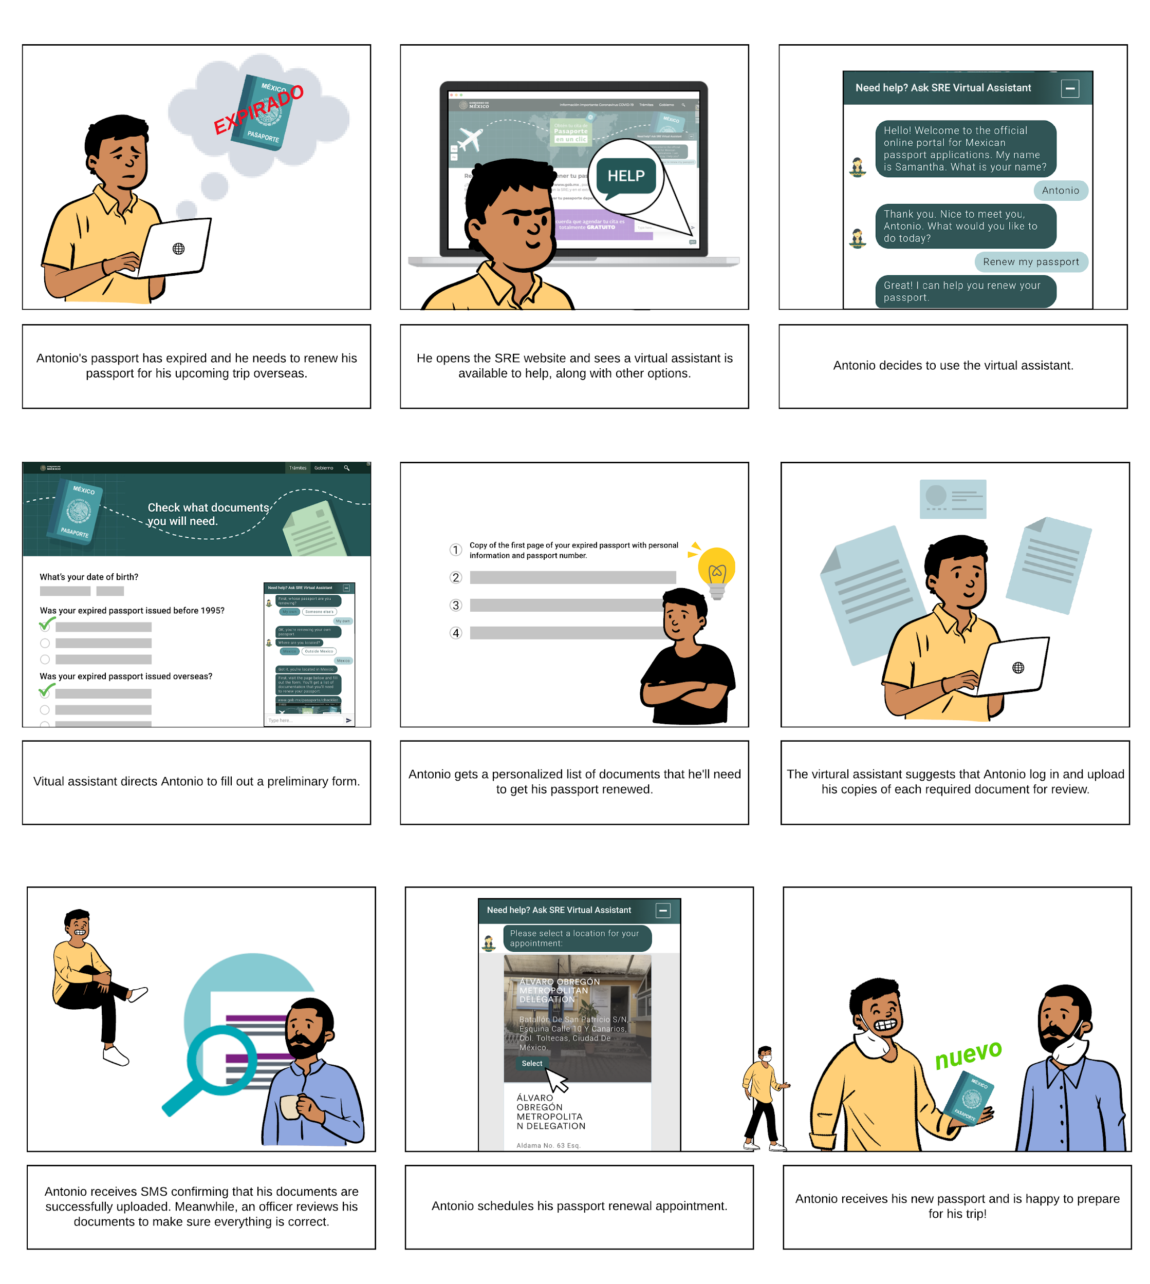
Storyboard 1-3
Notes:
Mojin
Antonio's passport has expired and he needs to renew his passport for his upcoming trip overseas.
He opens the SRE website and sees a virtual assistant is available to help, along with other options.
Antonio decides to use the virtual assistant.

Slide 18
Storyboard 3-6
Notes:
4) Virtual assistant directs Antonio to fill out a preliminary form.
5) Antonio gets a personalized list of documents that he'll need to get his passport renewed.
6) The virtual assistant suggests that Antonio log in and upload his copies of each required document for review.

Slide 19
Storyboard 6-9
Notes:
7) Antonio receives SMS confirming that his documents are successfully uploaded. Meanwhile, an officer reviews his documents to make sure everything is correct.
8) Antonio gets notified that his documents are all set, he then schedules his passport renewal appointment.
9) Antonio attends the appointment, receives his new passport, and is happy to prepare for his trip!

Slide 20
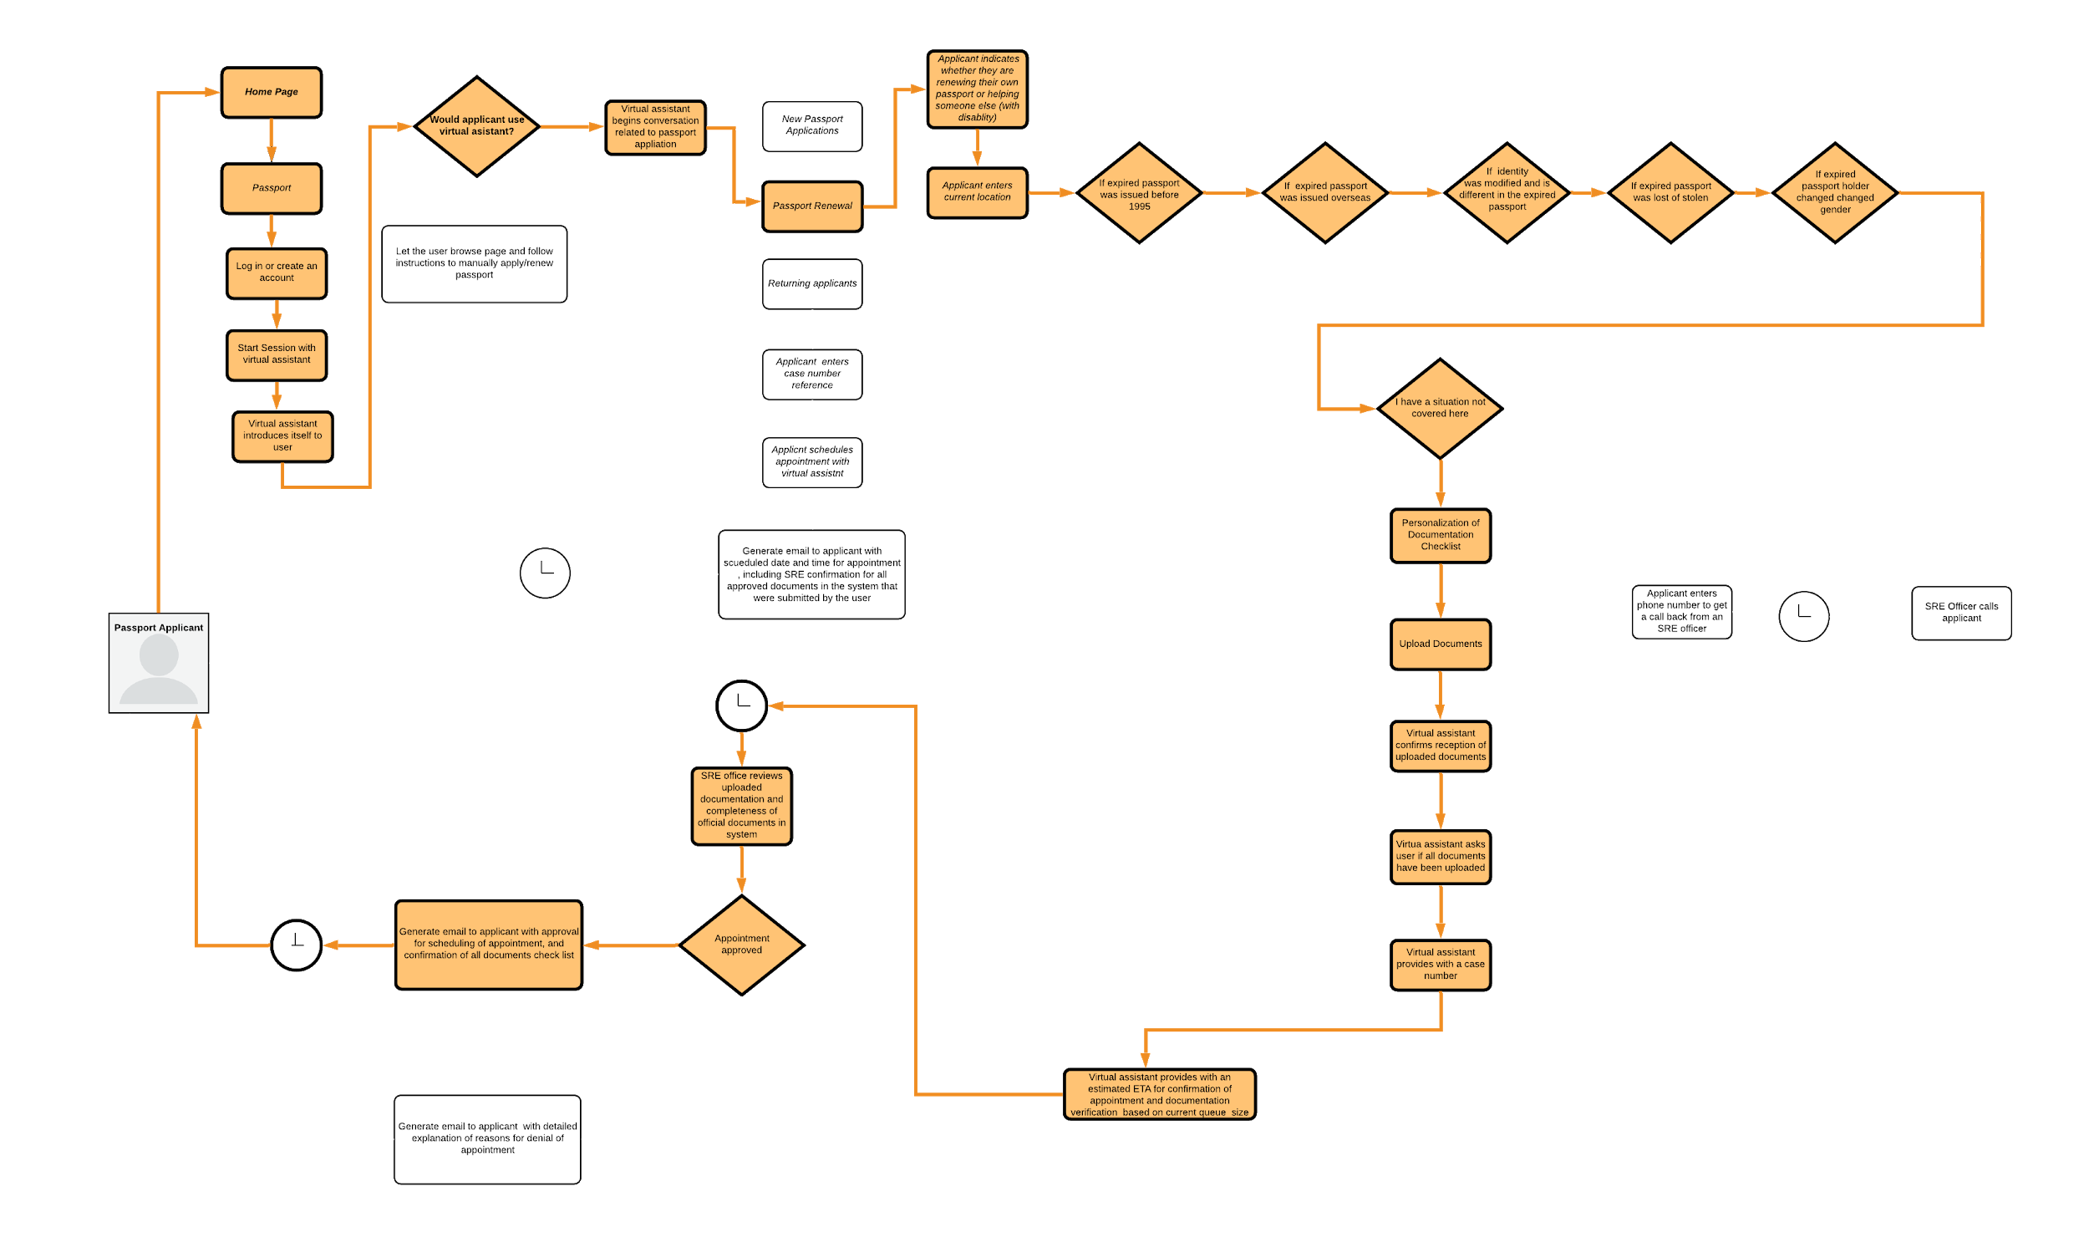
Interaction Design Flowchart
Happy Path
Alternate Path
Notes:
Antonio

Slide 21
Interaction Flowchart
high level current synchronous application process
Applicant visits government portal page and reads documentation requirements
Applicant makes a best effort on their own to determine what documentation is required
Applicant makes an appointment
At the appointment, government officials determine if documentation brought by applicant is correct
At the appointment, government officials determine if applicants required docs are already in database
If all documents are correct, the passport is processed and printed, otherwise a new appointment is needed
1
2
3`
4`
5`
6`
Applicant owns research for possible required documentation and appointment scheduling
Appointment with government with an uncertain application outcome
Timeline
Flow
Extra Possible Flow
Notes:
Antonio

Slide 22
Interaction Flowchart
Uncertainty Avoidance
Power Distance
Masculinity
High level proposed asynchronous application process
Applicant visits government portal page and meets a virtual assistant that will guide them in the application process
Applicant enters specific personal information and completes a multi choice selection form based on their situation
Based on the choices made, the system renders a check list of required documents
Applicant is ready to apply and uploads documents for review by a government official. He/She waits to hear from government official
1
2
3
4
Government official reviews uploaded documents and confirms all required documents already in database are correct
Approval notification is set to applicant
Timeline
Flow
5
6
Applicant gets approval notification and schedules appointment using virtual assistant
Applicant appears at government interview with certainty of outcome of application
Applicant gets their passport
7
8
9

Slide 23
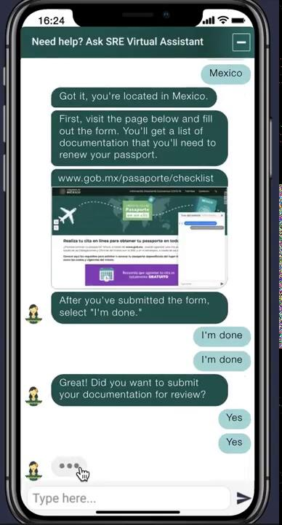
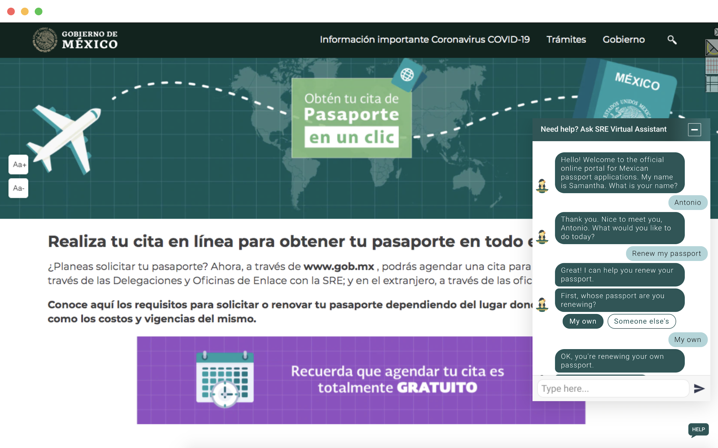
Mockup
Notes:
Antonio

Slide 24
THANK YOU
Notes:
Antonio

Slide 25
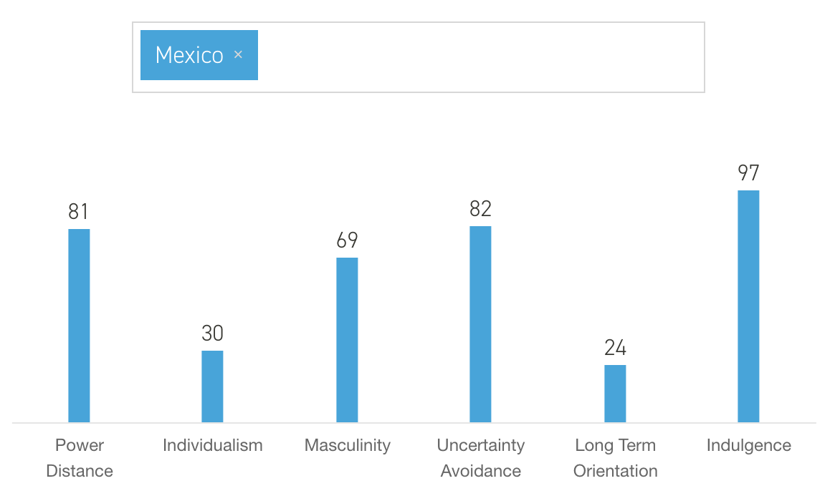
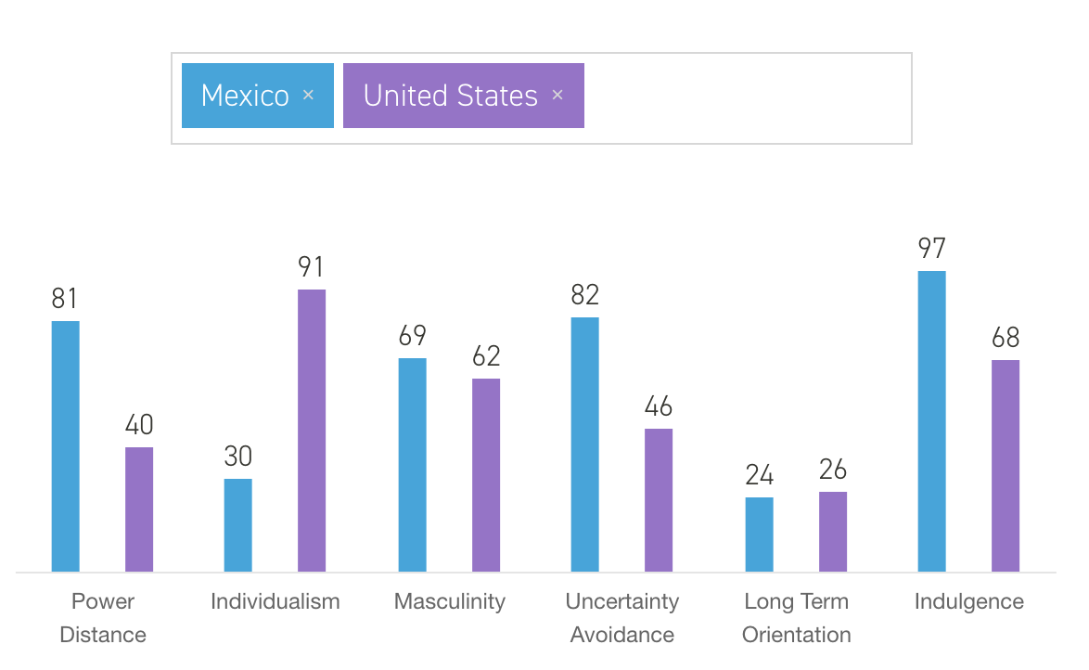
Appendix: Hofstede Insights

